Slide 1

Angular 6
Lesson 06

Slide 2
Template-Driven and Reactive Forms
Objectives

Slide 3
Template-Driven and Reactive Forms
Template-Driven vs Reactive Approach
Understanding Form State
Built-in Validators & Using HTML5 Validation
Grouping Form Controls
FormGroup, FormControl, FormBuilder, FormArray
Forms with Reactive Approach
Predefined Validators & Custom Validators
Async Validators
Showing validation errors

Slide 4
Template-Driven vs Reactive Approach

Slide 5
Template-Driven FORMS

Slide 6
Template Driven Forms
Forms build by writing templates in the Angular template syntax with the form-specific directives and techniques are called as Template Driven Forms.
The app component doesn't need to do much since the form fields and validators are defined in the template when using Angular template-driven forms
The component defines a model object which is bound to the form fields in the template in order to give you access to the data entered into the form from the app component
Using ngModel in a form gives you more than just two-way data binding. It also tells you if the user touched the control, if the value changed, or if the value became invalid.
The NgModel directive doesn't just track state; it updates the control with special Angular CSS classes that reflect the state.
Angular2 “infers” the FormGroup from HTML Code
Form data is passed via ngSubmit()
Notes:
The user should be able to submit this form after filling it in. The Submit button at the bottom of the form does nothing on its own, but it will trigger a form submit because of its type (type="submit").
A "form submit" is useless at the moment. To make it useful, bind the form's ngSubmit event property to the hero form component's onSubmit() method:
src/app/hero-form/hero-form.component.html (ngSubmit)content_copy<form (ngSubmit)="onSubmit()" #heroForm="ngForm">
The <input> element carries the HTML validation attributes: required and minlength. It also carries a custom validator directive, forbiddenName. For more information, see Custom validatorssection.
#name="ngModel" exports NgModel into a local variable called name. NgModel mirrors many of the properties of its underlying FormControl instance, so you can use this in the template to check for control states such as valid and dirty. For a full list of control properties, see the AbstractControl API reference.
The *ngIf on the <div> element reveals a set of nested message divs but only if the nameis invalid and the control is either dirty or touched.
Each nested <div> can present a custom message for one of the possible validation errors. There are messages for required, minlength, and forbiddenName.

Slide 7
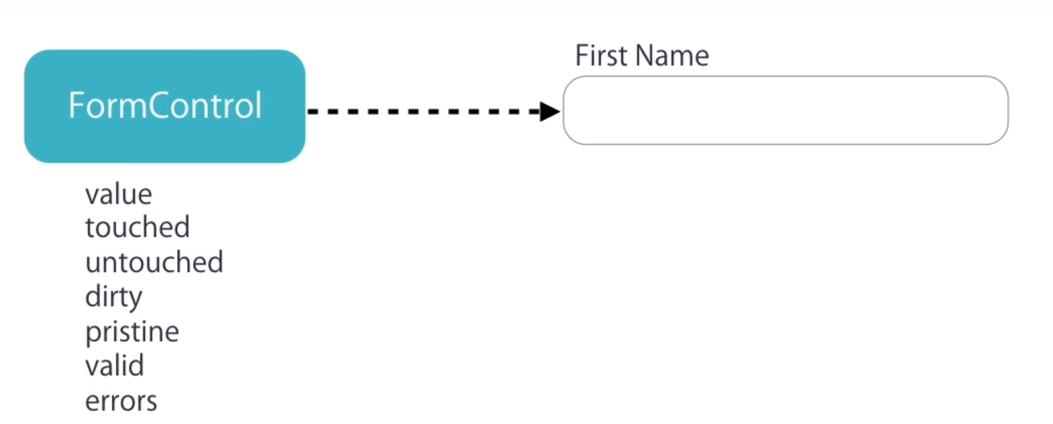
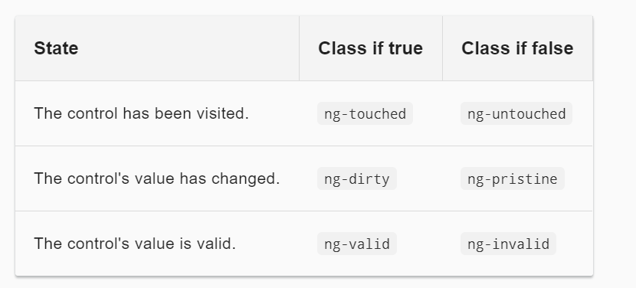
Understanding Form State
Notes:
The ng-valid/ng-invalid pair is the most interesting, because you want to send a strong visual signal when the values are invalid.
hide the message when the control is valid or pristine; "pristine" means the user hasn't changed the value since it was displayed in this form.
This user experience is the developer's choice. Some developers want the message to display at all times. If you ignore the pristine state, you would hide the message only when the value is valid. ISome developers want the message to display only when the user makes an invalid change. Hiding the message while the control is "pristine" achieves that goal. You'll see the significance of this choice when you add a new hero to the form.
Required - The form field is mandatroy
Maxlength - Maximum number of characters in the field.
Minlength - Minimum number of characters in the field.
Pattern - Regular expression to match the input values and validate.
Custom Validator - Writing custom validation function to match password and confirm password fields.

Slide 8
Validation
<form #empForm=ngForm (ngSubmit)="getData(empForm)">
<table>
<tr>
<td>Product ID</td>
<td><input required id="eid" name ="id" [(ngModel)]="emp.eId“
type="text" #idcontrol="ngModel"/>
<span *ngIf="idcontrol.invalid && idcontrol.touched" > ID is
required</span>
</td>
</tr>
<tr>
<td>Product Name</td>
<td><input required id="ename" name ="empname“
[(ngModel)]="emp.eName" type="text“
#namecontrol="ngModel"/></td>
<span *ngIf="namecontrol.invalid && namecontrol.touched" >
Name is required</span>
</tr>
</table>
</form>

Slide 9
Built-in Validators & Using HTML5 Validation

Slide 10
Grouping Form Controls

Slide 11
FormGroup, FormControl, FormBuilder, FormArray

Slide 12
Demo
Demo Template Driven Forms
Notes:
Add the notes here.
Add instructor notes here.

Slide 13
Reactive Forms

Slide 14
Forms with Reactive Approach
The app component defines the form fields and validators for our registration form using an Angular FormBuilder to create an instance of a FormGroup that is stored in the registerForm property.
The registerForm is then bound to the form in the template below using the [formGroup] directive.
Also need to be added a getter 'f' as a convenience property to make it easier to access form controls from the template. So for example you can access the email field in the template using f.email instead of registerForm.controls.email.

Slide 15
Forms with Reactive Approach
import { Component, OnInit } from '@angular/core';
import { FormBuilder, FormGroup, Validators } from '@angular/forms';
@Component({
selector: 'app',
templateUrl: 'app.component.html'
})
export class AppComponent implements OnInit {
registerForm: FormGroup;
submitted = false;
constructor(private formBuilder: FormBuilder) { }
ngOnInit() {
this.registerForm = this.formBuilder.group({
firstName: ['', Validators.required],
lastName: ['', Validators.required],
email: ['', [Validators.required, Validators.email]],
password: ['', [Validators.required, Validators.minLength(6)]]
});
}
// convenience getter for easy access to form fields
get f() { return this.registerForm.controls; }
onSubmit() {
this.submitted = true;
// stop here if form is invalid
if (this.registerForm.invalid) {
return;
}
alert('SUCCESS!! :-)')
}
}

Slide 16
Forms with Reactive Approach
<form [formGroup]="registerForm" (ngSubmit)="onSubmit()">
<div class="form-group"> <label>First Name</label>
<input type="text" formControlName="firstName" class="form-control" [ngClass]="{ 'is-invalid': submitted && f.firstName.errors }" />
<div *ngIf="submitted && f.firstName.errors" class="invalid-feedback">
<div *ngIf="f.firstName.errors.required">First Name is required</div> </div> </div>
<div class="form-group"> <label>Last Name</label>
<input type="text" formControlName="lastName" class="form-control" [ngClass]="{ 'is-invalid': submitted && f.lastName.errors }" />
<div *ngIf="submitted && f.lastName.errors" class="invalid-feedback">
<div *ngIf="f.lastName.errors.required">Last Name is required</div> </div> </div>
<div class="form-group"> <label>Email</label>
<input type="text" formControlName="email" class="form-control" [ngClass]="{ 'is-invalid': submitted && f.email.errors }" />
<div *ngIf="submitted && f.email.errors" class="invalid-feedback">
<div *ngIf="f.email.errors.required">Email is required</div>
<div *ngIf="f.email.errors.email">Email must be a valid email address</div> </div> </div>
<div class="form-group"> <label>Password</label>
<input type="password" formControlName="password" class="form-control" [ngClass]="{ 'is-invalid': submitted && f.password.errors }" />
<div *ngIf="submitted && f.password.errors" class="invalid-feedback">
<div *ngIf="f.password.errors.required">Password is required</div>
<div *ngIf="f.password.errors.minlength">Password must be at least 6 characters</div></div> </div>
<div class="form-group"> <button [disabled]="loading" class="btn btn-primary">Register</button>
</div> </form>

Slide 17
Predefined Validators & Custom Validators

Slide 18
Async Validators

Slide 19
Showing validation errors

